Slide 1
Java Programming
Data Types in Java
By Kaustubh Wahane

Slide 2
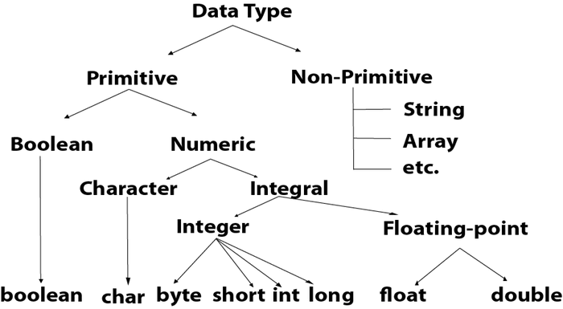
Basic flow chart of data types

Slide 3
Data types specify the different sizes and values that can be stored in the variable. There are two types of data types in Java:
Primitive data types: The primitive data types include boolean, char, byte, short, int, long, float and double.
Non-primitive data types:
The non-primitive data types include
Classes, Interfaces, Array
The main difference between primitive and non-primitive data types is that primitive data types are pre-defined i.e. they are already defined in Java whereas the non-primitive data types are defined by the user and can be different depending upon user.
A primitive type starts with a lowercase letter, while non-primitive types start with an uppercase letter.

Slide 4
Following are the values and sizes of there respective data types. Note that this values are used by a constructor in which this values are inputted by default in Java.
Data Type | Default Value | Default size
boolean | false | 1 bit
char | '\u0000' | 2 byte
byte | 0 | 1 byte
short | 0 | 2 byte
int | 0 | 4 byte
long | 0L | 8 byte
float | 0.0f | 4 byte
double | 0.0d | 8 byte

Slide 5
Primitive Data types
Boolean-The Boolean data type is used to store only two possible values: true and false.
Char-The char data type is used to store characters.
Byte-It is an 8-bit signed two's complement integer. Its value-range lies between -128 to 127
Short-The short data type is a 16-bit signed two's complement integer.
Int - This data type is a 32-bit signed two's complement integer.

Slide 6
Long-The long data type is a 64-bit two's complement integer.
Float-It is recommended to use a float (instead of double) if you need to save memory in large arrays of floating point numbers.
Double-The double data type is generally used for decimal values just like float.

Slide 7
Types of Non-Primitive Data types
There are five types of non-primitive data types in Java. They are as follows:
Class
Object
String
Array
Interface

Slide 8
Class-A Class in Java is a user defined data type i.e. it is created by the user. It acts a template to the data which consists of member variables and methods.
Object-The Object data type can point to data of any data type meaning it can store the necessary data you want to access by calling certain method.
String -A string represents a sequence of characters etc . It is a string is the class of Java.

Slide 9
Array -An array is a data type which can store multiple homogenous variables i.e., variables of same type in a sequence.
Interface-An interface is similar to a class however the only difference is that its methods are abstract by default .An interface has only the final variables and method declarations.

Slide 10


